Slide 1
Analyze Indicators of Malicious Activity
CompTIA Security+ Exam SY0-701
Lesson 13
Notes:
This lesson concludes the "detect and respond" phase of the course by looking at the mechanisms used to effect an intrusion and identifying TTPs and indicators.

Slide 2
Objectives
Analyze indicators of malicious activity in malware, physical, network, and application attacks

Slide 3
Malware Attack Indicators
Lesson 13
Topic 13A
Notes:
Coverage of Objective 2.4 is split among three topics to make the presentation more manageable. This first part covers malware and general indicators.
Basic malware types are covered in exams from ITF+ up, but ensure students can distinguish all the types listed here. Try to focus on detection of indicators.

Slide 4
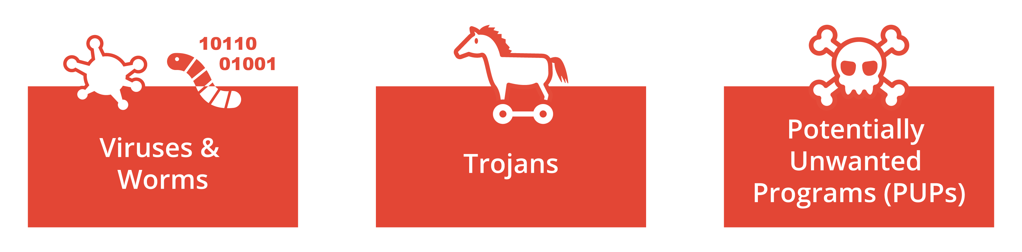
Malware Classification​
Classification by vector or infection method​
Viruses and worms​
  Spread within code without authorization​
Trojans​
  A malicious program concealed within a benign one​
Potentially unwanted programs/applications (PUPs/PUAs)​
  Pre-installed “bloatware” or installed alongside another app​
  Not completely concealed, but installation may be covert​
  Also called grayware​
Classification by payload ​
Notes:
Try to distinguish methods that classify malware by the vector from those that describe the payload. The vector is the means by which the malware is able to execute. The payload expresses the threat actor's objective.

Slide 5
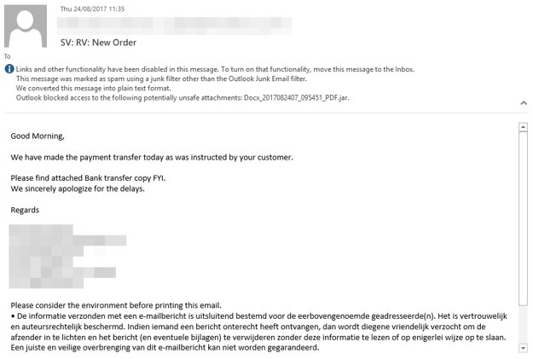
Computer Viruses​
Rely on some sort of host file or media​ delivery vector
  Non-resident/file infector​
  Memory resident​
  Boot​
  Script/macro ​
Screenshot used with permission from Microsoft.
Notes:
Explain that the term "virus" came about because the goal of the first virus writers (back in the 1980s) was to demonstrate how code could be made to infect files, spread between files within a computer system, and spread to other hosts.

Slide 6
Computer Worms and Fileless Malware​
Early computer worms​
  Propagate in memory/over network links​
  Consume bandwidth and crash process​
Fileless malware​
  Exploiting remote execution and memory residence to deliver payloads​
  May run from an initial script or Trojan​
  Persistence via the registry​
  Use of shellcode to create backdoors and download additional tools​
  “Living off the land” exploitation of built-in scripting tools​
Advanced persistent threat (APT)/advanced volatile threat (AVT)/​
low observable characteristics (LOC)​
Notes:
Where a virus requires a file or media to replicate, worms and fileless can replicate between processes in memory on the local host and over network shares.
Fileless is tricky to define exactly, but it illustrates the wide range of vectors that threat actors can exploit.

Slide 7
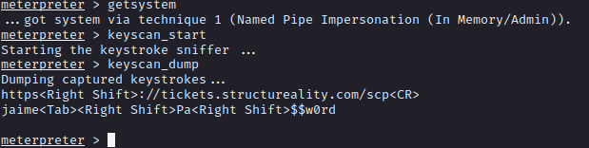
Spyware, Adware, and Keyloggers​
Tracking cookies​, supercookies, and beacons
Adware (PUP/bloatware)​
  Changes to browser settings​
Spyware (malware)​
  Log all local activity​
  Use of recording devices and screenshots​
  Redirection​
Keylogger​
  Software and hardware​
Notes:
Spyware/keylogger is a means of classifying malware by its purpose, rather than vector.

Slide 8
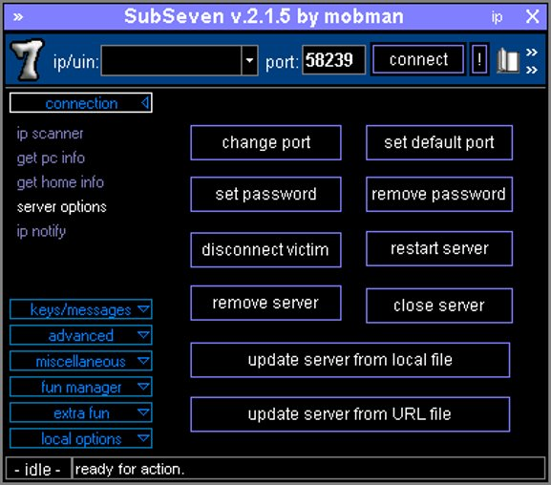
Backdoors and Remote Access Trojans​
Backdoor malware​
Remote access trojan (RAT)​
Bots and botnets​
Command & control (C2 or C&C)​
Backdoors from misconfiguration and unauthorized software​
Screenshot used with permission from Wikimedia Commons by CCAS4.0 International.

Slide 9
Rootkits
Local administrator versus SYSTEM/root privileges​
Replace key system files and utilities​
Purge log files​
Firmware rootkits​

Slide 10
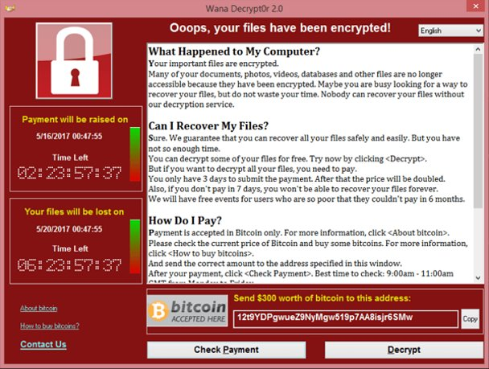
Ransomware, Crypto-Malware, and Logic Bombs​
Ransomware​
  Nuisance (lock out user by ​
  replacing shell)​
Crypto-malware​
  High impact ransomware (encrypt data files or drives)​
Cryptomining/crypojacking​
  Hijack resources to mine cryptocurrency​
Logic bombs​​
Image by Wikimedia Commons.

Slide 11
TTPs and IoCs
Signature detection by anti-virus often ineffective
Tactics, Techniques, and Procedures (TTPs)
Indicators of Compromise (IoCs)
Documented and published TTPs and IoCs
  MITRE ATT&CK
  Pattern-matching via artificial intelligence (AI) systems
Notes:
Make sure students can use this terminology.

Slide 12
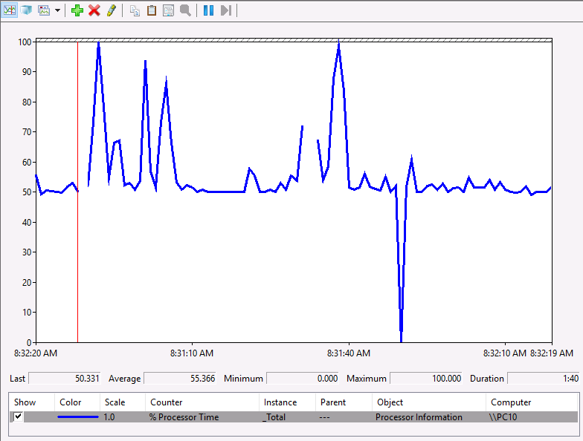
Malicious Activity Indicators​
Browser changes or overt ransomware notification​
Sandbox execution​
Resource consumption​
File system
  Blocked content
Resource inaccessibility
Account compromise
Logging
  Missing and out-of-cycle logging
Windows Performance Monitor recording CPU utilization on a client PC. Anomalous activity is difficult to diagnose, but this graph shows load rarely dropping below 50%. Continual load is not typical of a client system, and could be an indicator of cryptojacking malware. (Screenshot used with permission from Microsoft.)
Notes:
Make sure students know which tools to use to collect indicators of malware presence and type.

Slide 13
Malware Attack Indicators
Malware classification​
  Vector versus payload
Computer viruses​
Computer worms and fileless malware​
Spyware, adware, and keyloggers​
Backdoors and remote access trojans​
Rootkits
Ransomware, crypto-malware, and logic bombs​
TTPs and IOCs
Malicious activity indicators​
  Resource consumption, file system, resource inaccessibility, account compromise, logging

Slide 14
Physical and Network Attack Indicators
Lesson 13
Topic 13B
Notes:
Make sure students can categorize these attack types and know which data sources to use for investigations.

Slide 15
Physical Attacks
Brute force
  Physical denial of service
  Breaking into premises/cabinets
Environmental
RFID cloning and skimming
  Radio Frequency Identification (RFID) and Nearfield Communications (NFC)
  Contactless cards, badges, and fobs
  Static tokens versus cryptoprocessors

Slide 16
Network Attacks
Reconnaissance and credential harvesting
Denial of service
Weaponization/delivery/breach
Command and control (C2 or C&C), beaconing, and persistence
Lateral movement, pivoting, and privilege escalation
Data exfiltration

Slide 17
Distributed Denial of Service Attacks (1)
Leverage bandwidth from compromised hosts/networks
  Handlers form a command and control (C&C) network
  Compromised hosts installed with bots that can run automated scripts
  Co-ordinated by the C&C network as a botnet
Overwhelm with superior bandwidth (number of bots)
Consume resources with spoof session requests (SYN flood)
Notes:
Botnets can comprise millions of infected hosts. Threat actors can martial sufficient resources to perform DDoS attacks of up to two terabits per second.

Slide 18
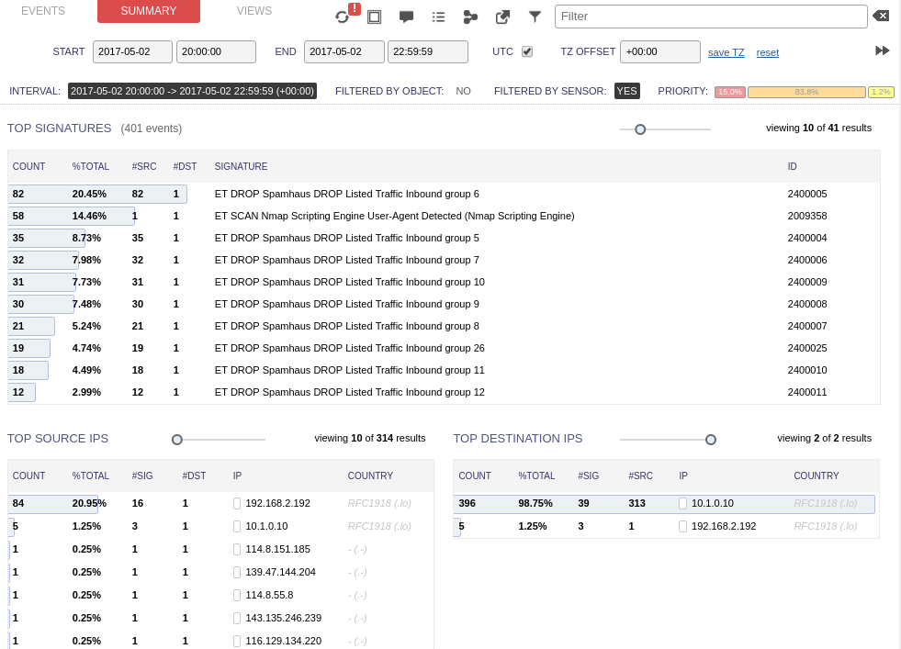
Distributed Denial of Service Attacks (2)
Reflected attacks
  Spoof victim's IP address and attempt to open connections with multiple servers
  Those servers direct their SYN/ACK responses to the victim
Amplified attacks
  Bogus DNS/NTP queries
  Direct responses at victim
  Queries can be constructed to generate large response packets
DDoS indicators
Dropping traffic from blocklisted IP ranges using Security Onion IDS. (Screenshot used with permission from Security Onion.)

Slide 19
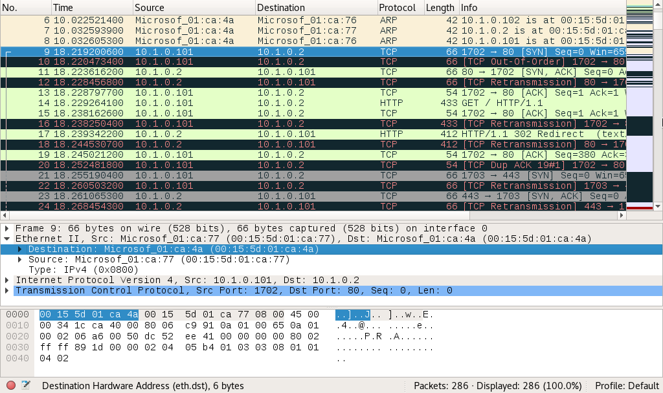
On-path Attacks
Threat actor positioned between two hosts
  “Man-in-the-middle”
  Can target forwarding/protocols at different network layers
Address Resolution Protocol (ARP) poisoning
  Broadcasting unsolicited ARP replies to poison the cache of local hosts with spoofed MAC address
  Attacker usually tries to masquerade as default gateway
Screenshot used with permission from wireshark.org.
Notes:
As with vector and payload with malware, it's helpful to distinguish the attack vector with what the threat actor is trying to achieve.
Explain that on-path means that the threat actor gains control over forwarding. There are many different specific on-path attack vectors, but most try to achieve the same sort of snooping goal.

Slide 20
Domain Name System Attacks
Attacks on public DNS services
  Typosquatting, DRDoS, and hijacking
DNS poisoning
DNS-based on-path attacks
  Get client to use malicious resolver
DNS client cache poisoning
  HOSTS file
DNS server cache poisoning
DNS attack indicators
Notes:
Ensure students understand that DNS attack types are many and varied in terms of both vectors and goals, but most achieve some sort of on-path attack by corrupting name resolution to intercept user traffic.
Most operating systems will use HOSTS before any other type of name resolution, though this behavior can be changed.

Slide 21
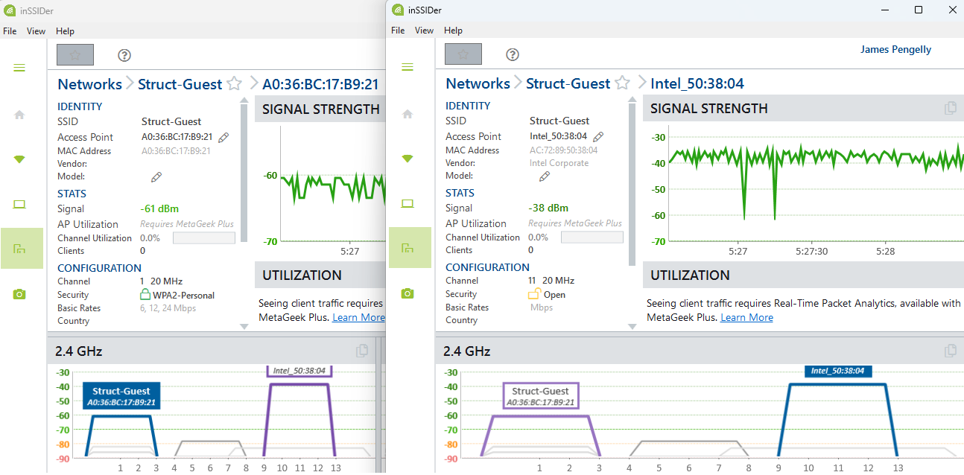
Wireless Attacks
Rogue access points
  Non-malicious backdoors
  Evil twins masquerade as legitimate AP
  Launch on-path attacks
  Indicators and detection
Wireless denial of service
  Jamming and disassociation
Wireless replay and key recovery
Screenshot used with permission from MetaGeek.
Notes:
Stress the importance of disabling unused connections and services and scanning for rogue systems.

Slide 22
Password Attacks​
Online password attack​
  Adversary interacts with authentication service​
Offline attacks​
  Password database​
  Hash transmitted directly​
  Hash used as key to sign an HMAC​​
Brute force attack
Dictionary and hybrid attacks
Password spraying​
Notes:
You might want to note the use of machine learning to facilitate brute force attacks.
You can direct students to a brute force calculator to test a few passwords (grc.com/haystack.htm, for example).

Slide 23
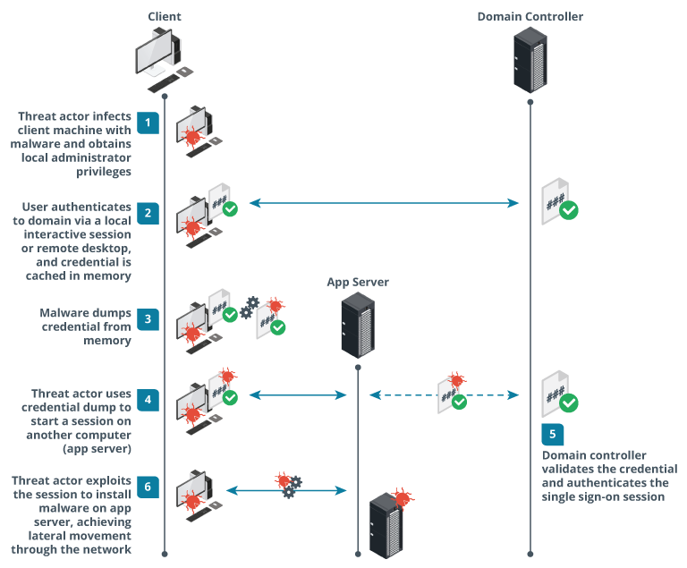
Credential Replay Attacks
Credential dumping against Windows cached credentials
  Kerberos tickets
  NTLM hashes
  Reversible encryption passwords
Credential replay against hosts and applications
  Pass the hash (PtH) against NTLM
  Pass the ticket (PtT) against Kerberos
Images © 123rf.com.
Notes:
Remind students how Kerberos works:
* User authenticates to the KDC (domain controller) to obtain a TGT.
* User presents the TGT to an application to obtain a TGS or service ticket. The application verifies the user's TGT with the KDC.
Note that the NT hash format is used to store credentials, even if the NTLM authentication protocol has been disabled. There's a good deal more complexity to this topic. You can point students to learn.microsoft.com/en-us/windows-server/security/kerberos/passwords-technical-overview for more information.
One of the principal takeaways from the threat of credential dumping is to strictly control which client workstations are used by domain administrators or other similarly high-privilege admin accounts.

Slide 24
Cryptographic Attacks
Downgrade attacks
  Reduce transport encryption version/force use of weak cipher suites
  Use weak cipher suites in Kerberos
Collision attacks
  Forge digital signatures
Birthday attacks
  Design more efficient collision attacks

Slide 25
Malicious Code Indicators
Shellcode
Credential dumping
Lateral movement
  Psexec
  PowerShell code
Persistence
  Registry keys
  Scheduled tasks
Notes:
Note that indicators are mostly gathered from the way a malicious process interacts with the system. This evidence is gathered through logging. The purpose of EDR-type products is to provide real-time automated analysis of code execution.

Slide 26
Physical and Network Attack Indicators
Physical attacks
  Brute force, environmental, card cloning
Network attacks
  Reconnaissance, weaponization, C&C, data exfiltration
Distributed denial of service attacks
On-path, Domain Name System, and wireless attacks
Password and credential replay attacks
Cryptographic attacks
Malicious code indicators
  Shellcode, credential dumping, lateral movement/pivoting, persistence

Slide 27
Application Attack Indicators
Lesson 13
Topic 13C
Notes:
This topic deals with the remainder of the application attack content examples, which mostly refer to web application server and client vulnerabilities and exploits.
Note that there's some overlap with Objective 2.3 (covered in Lesson 8), part of which discusses application vulnerabilities.

Slide 28
Application Attacks
Attacks that target vulnerabilities in application code or architecture/design
Privilege escalation
  Get privileges from target vulnerable process to run arbitrary code
  Remote execution when code is transferred from another machine
  Vertical and horizontal privilege escalation
  Detect by process logging and auditing plus automated detection scanning
Buffer overflow
Notes:
Note that in most cases, a successful attack can only be identified through the behavior of the compromised process of the host, in terms of file system and network activity.

Slide 29
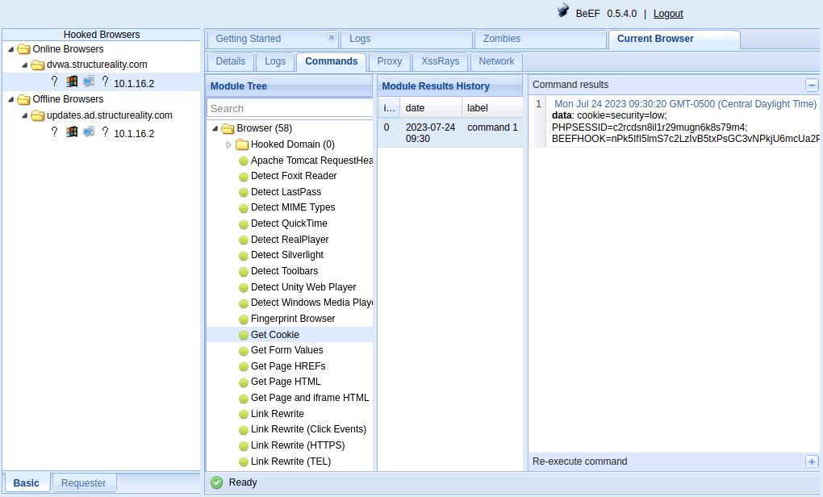
Replay Attacks
Resubmitting or guessing authorization tokens
Session management cookies
Replay cookie to obtain authenticated session
Using The Browser Exploitation Framework (BeEF) to obtain the session cookie from a browser.
Notes:
The following pages focus on describing attack types and providing illustrations of the type of code associated with them, where possible.
URL and log analysis to discover the indicators is covered at the end of the topic.

Slide 30
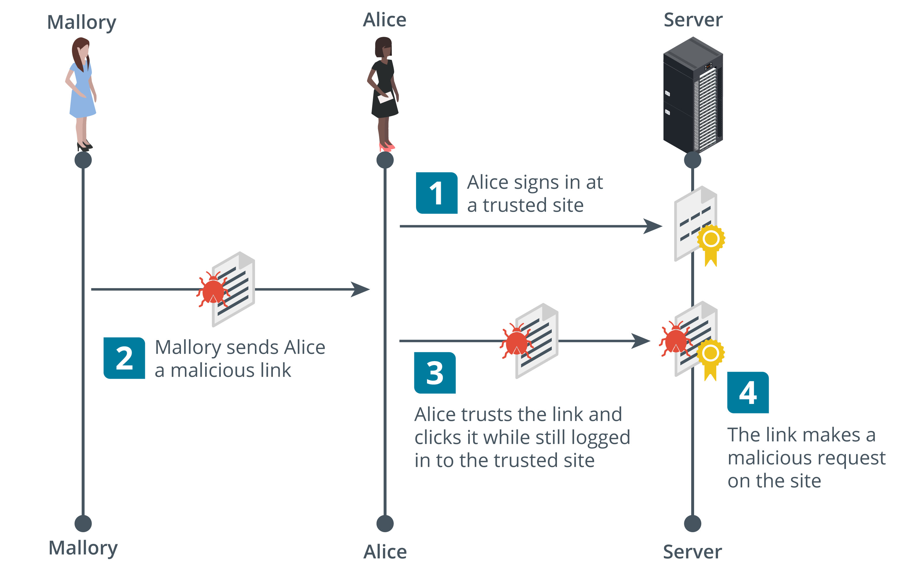
Forgery Attacks (1)
Cookie hijacking and session prediction
Client-side/cross-site (CSRF/XSRF) request forgery
  Passes a URL to another site where the user has an authenticated session
  Confused deputy
Images © 123rf.com.

Slide 31
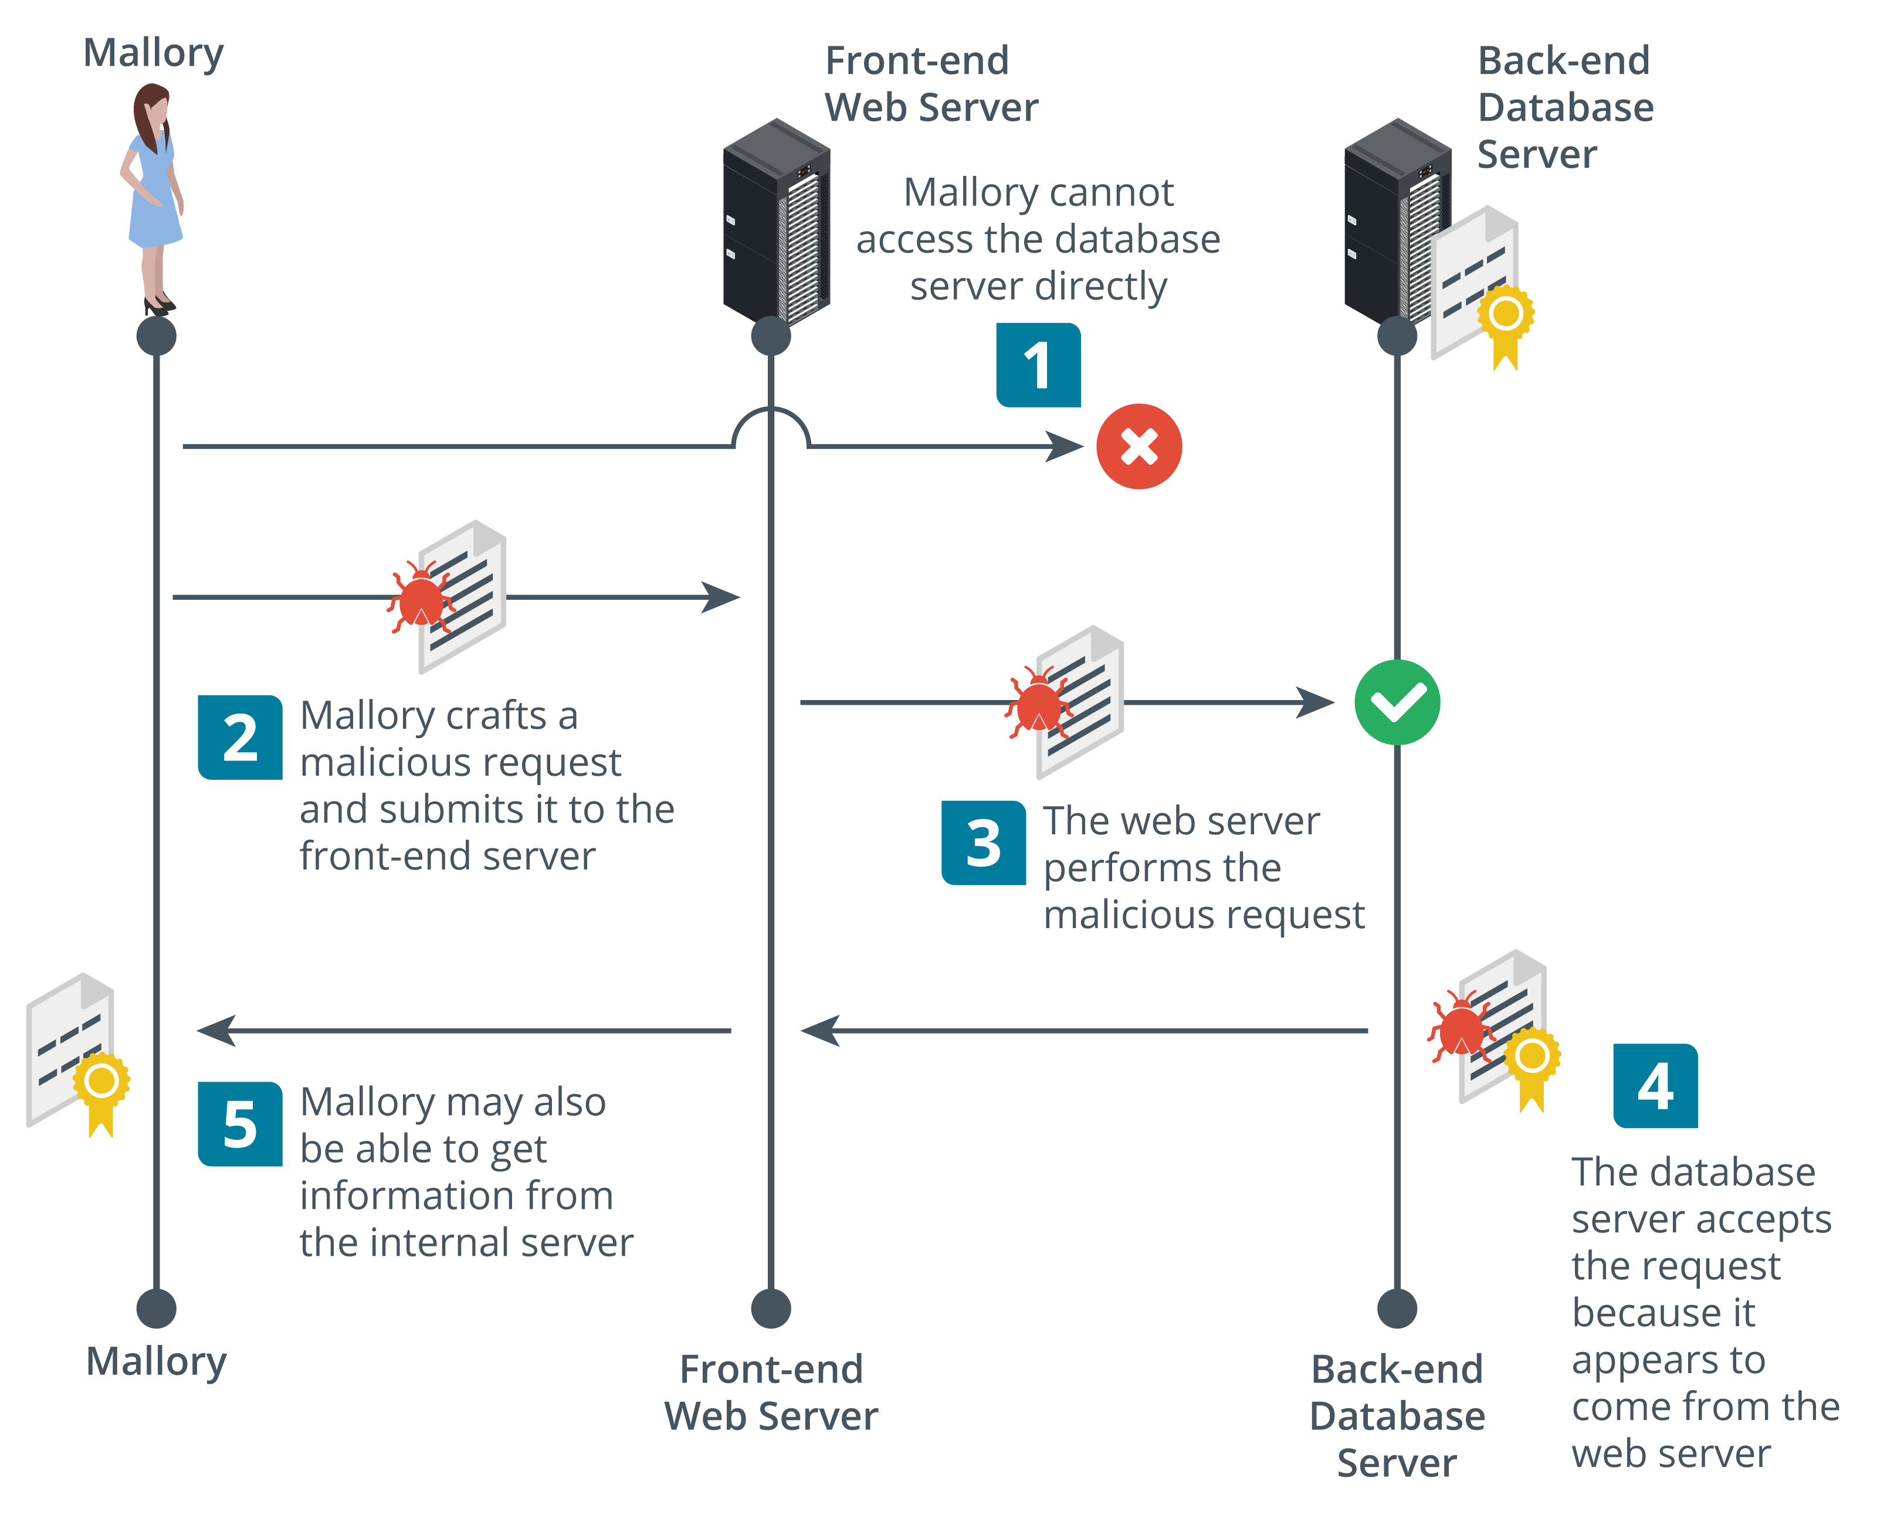
Forgery Attacks (2)
Server-side Request Forgery (SSRF)
Cause a server to make API calls or HTTP requests with arbitrary parameters
  Weak authentication/access control between internal services
  Weak input validation and faults in request parsing
Images © 123rf.com.

Slide 32
Injection Attacks
Persistent XSS and SQL injection
Extensible Markup Language (XML) injection
  XML tagged documents
  XML External Entity (XXE) to exfiltrate data and files
Lightweight Directory Access Protocol (LDAP) injection
  Query language to read and update network directories
SELECT * FROM tbl_user WHERE username = '' or 1=1--#
<?xml version="1.0" encoding="UTF-8"?>
<!DOCTYPE foo [<!ELEMENT foo ANY ><!ENTITY bar SYSTEM "file:///etc/config"> ]>
<bar>&bar;</bar>
(&(username=Bob)(&))
Notes:
Note that a client-side attack is where the browser runs the malicious code. This might trigger some action on the server, but it is client-side because the browser is coding the request.
Refer students back to Lesson 8 for notes on XSS and SQLi.
Make sure students can identify XML and LDAP syntax.

Slide 33
Directory Traversal and Command Injection Attacks
Directory traversal
  Obtain access to files outside web site root directory
  Canonicalization attack and percent encoding
Command injection
  Cause server to run OS shell commands
http://victim.foo/?show=../../../../etc/config
http://victim.foo/?show=%2e%2e%2f%2e%2e%2f%2e%2e%2f%2e%2e%2fetc/config

Slide 34
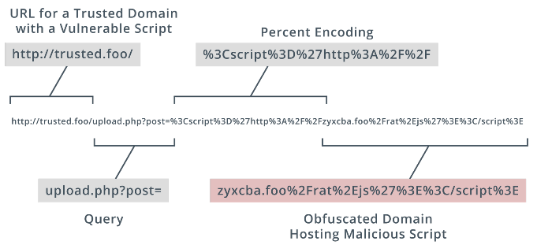
URL Analysis
Uniform Resource Locator (URL) format
HTTP methods
  TCP connections
  GET, POST, PUT
  URL (query parameters)
Percent encoding
Notes:
Get students to open a site in a browser and inspect the URL as they browse different pages. Get them to inspect requests and headers using developer tools.

Slide 35
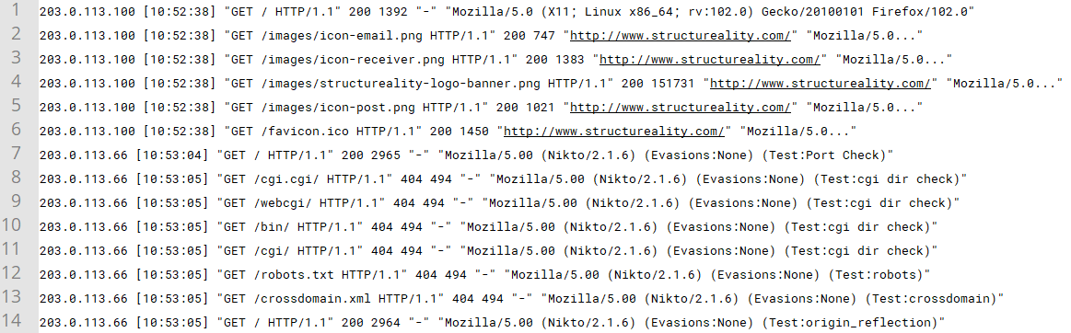
Web Server Logs
Error log
Traffic log
Status codes
HTTP headers
Notes:
You don't need to go through these in detail in class. Just make sure students know what type of information can be retrieved from each type of data source.

Slide 36
Application Attack Indicators
Application attacks
  Arbitrary/remote code execution, privilege escalation, buffer overflow
Replay attacks
Forgery attacks
  Cross-site and server-side forgery
Injection attacks
  SQL, XML, LDAP, directory traversal, command injection
URL analysis
Web server logs

Slide 37
Summary
CompTIA Security+ Exam SY0-701
Lesson 13
Notes:
Check that students are confident about the content that has been covered. If there is time, revisit any content examples that they have questions about. If you have used all the available time for this lesson block, note the issues and schedule time for a review later in the course.
Optionally, discuss with students how they might have experience with attacks, the impact they had, and how they were resolved.

